Slide 1
Project 2 - Domain Modeling
Group CCAAC

Slide 2
Use Case Document Fixes
Cleaned up formatting
Removed unnecessary steps in flow descriptions
Added small changes to some use cases to clarify meaning and consistency with the requirements.
1. Informing player sending a trade invite about accepts/declines.
2. Systematic functions associated with deleted accounts.
3. Systematic functions related to selecting a username.
etc.

Slide 3
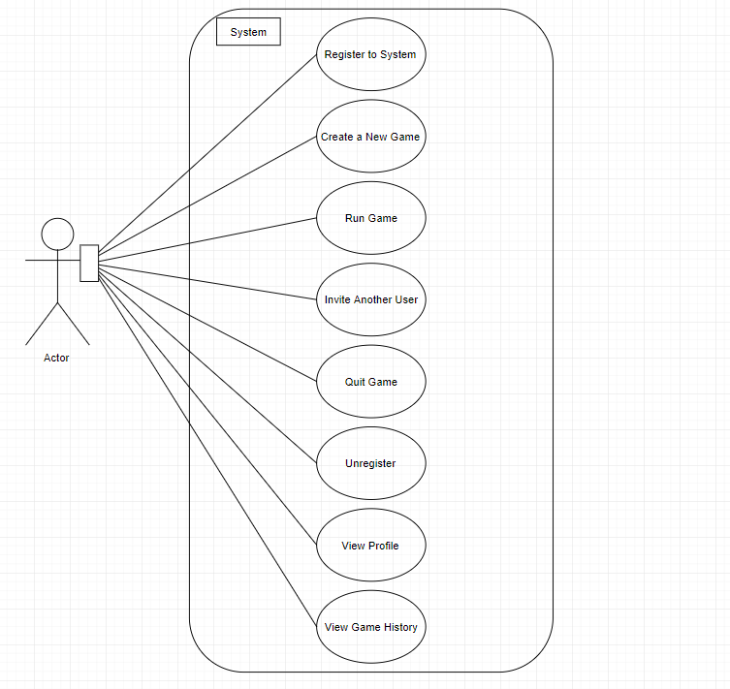
Use Case Diagram Fixes
Removed “System” as an actor.
Fixed inconsistent naming in diagram and document
Added a use case that was neglected in the first iteration
Player

Slide 4
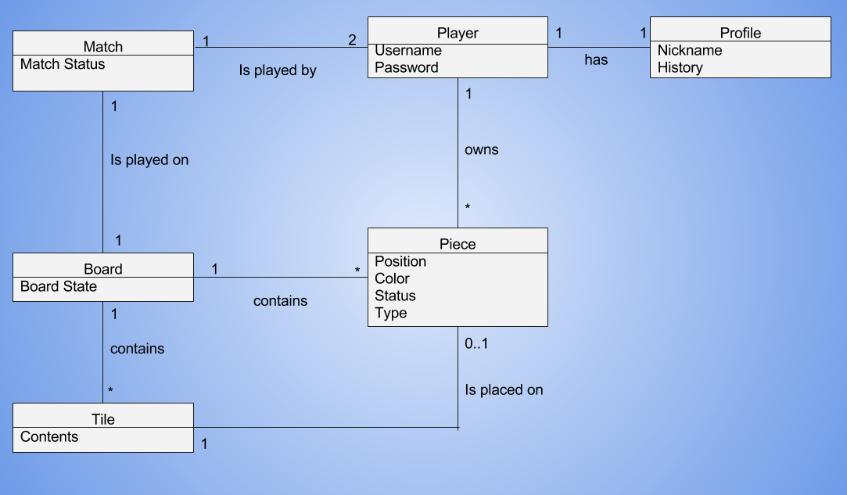
Domain Model Overview

Slide 5
Some Attributes and Associations
Attributes
It was decided that Match, Board, and Piece would contain a status/state attribute to keep track of game completeness, game progress, and whether or not a Piece has been taken.
Associations
The association between a Player and a Piece was decided to have a 1->* multiplicity because in Hnefatafl both players have different numbers of pieces. Pieces can be “lost” in a given game as well.

Slide 6
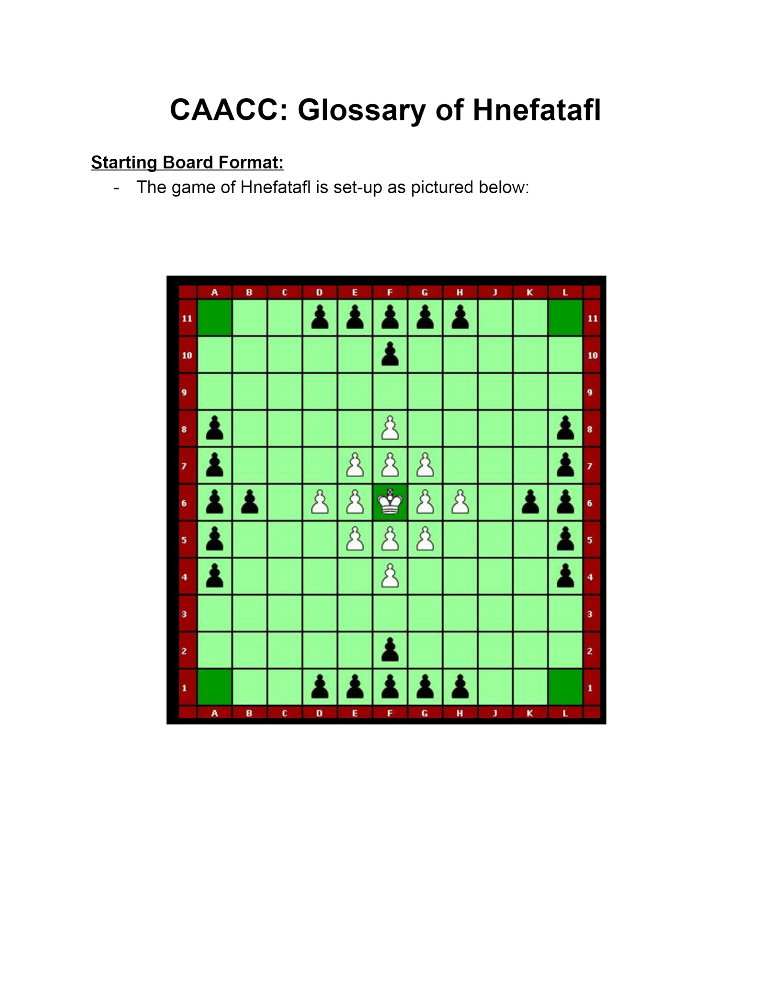
Glossary Highlights
Game Rules (Most common)
One team starts with a large number of pawns, the other with a smaller number of pawns and a king.
Pieces move similarly to a rook
Capturing a pawn involves “sandwiching” it between two pieces.
The goal of the defenders is to capture the king (must be sandwiched by 4 pieces.
The goal of the defenders is to escort the king to a corner.

Slide 7
Decisions and Uncertainties
In the domain model:
Including a Tile class
Better to account for “special” tiles like the center and corners.
Tracks the Piece occupying the tile.
Excluding individual Piece classes
Unnecessary, pieces have the same move sets.
Only difference being the King’s capture leading to end state.

Slide 8
Decisions and Uncertainties (cont.)
In the glossary:
Size of the board
Games of Hnefatafl can be played on a range of board sizes.
Need to verify with the client on whether or not a 11x11 board is appropriate.
History of locations based Hnefatafl “House Rules”
The game rules tend to vary by the country of play.
Some “rules” call for 4-sided capture; most call for 2-sided.
Again, needing to verify with client before proceeding.

Slide 9
Questions?

